Slide 1
Identifying health inequalities within elective waiting lists and factors leading to emergency admission
Simon Wellesley-Miller
Senior Analytical Manager
South West Performance Analysis Team
NHS England
MSc Student
Healthcare Data Science
University of Exeter

Slide 2
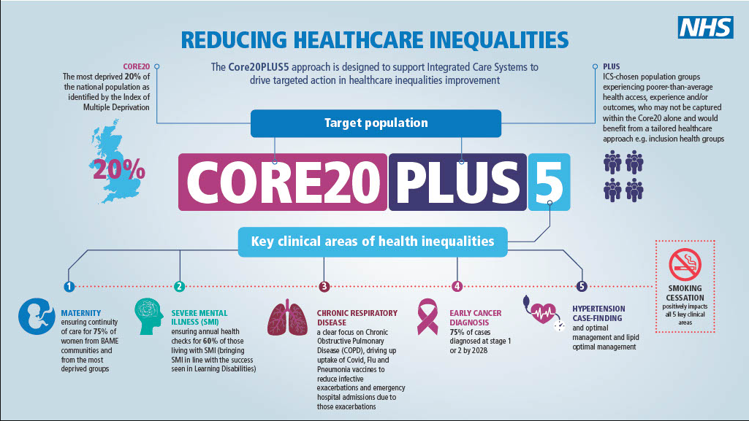


Project objectives
To understand where there has been significant impacts on health inequalities in the South West, with respect to accessing acute services during Covid 19.
Outputs of the project will support future areas of focus to address the gap in ensuring accessing services is equitable across the South West.
Analysis to support this project should be automated and available to enable continuation post MSc and become part of business as usual.
Definitions
Health inequalities are systematic differences in the health status of different population groups. These inequities have significant social and economic costs both to individuals and societies. ⁽¹⁾
Waiting list - A list of patients waiting to receive a consultative, assessment, diagnosis, care or treatment activity from an organisation.
The list is maintained for an identified care professional or service within an organisation. ⁽²⁾
Emergency admission - Patients admitted to hospital when admission is unpredictable and at short notice because of clinical need. ⁽²⁾
Notes:
Project was around identifying health inequalities
Covid – massive waiting lists – 8 years to 2020 went from 3m to 4m then to 6.5m in 2 years
Big part of remit was to produce a tool
Something that was automated and reproducible

Slide 3
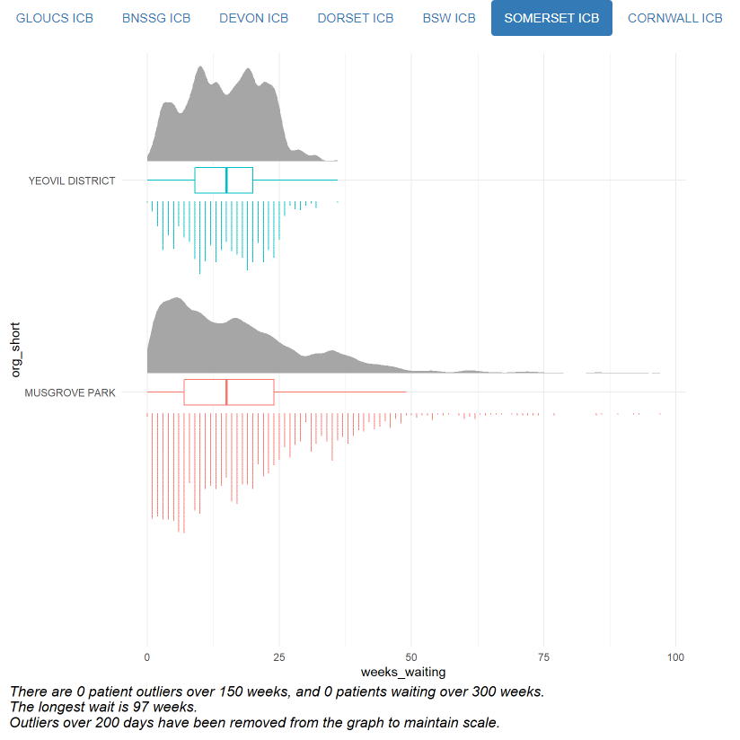
What does a waiting list look like?
There is not a single waiting list – is by treatment function
and by organisation
Looking at South West Region, over 50+ organisations,
each its own independent lists across 150+ treatment
functions
Waiting lists are far from normally distributed
There is also an issue that patients that are waiting may become an emergency admission.
Linking the waiting list dataset to ED attendances and Emergency Admission data, train a model to identify features that may lead to emergency admission
Hospital X
Hospital X
Notes:
Each waiting list is different
There are in effect over 7500 waiting lists in south west
Waiting lists are not normally distributed – or even a fitted distribution
Also wanted to test if there was a link between waiting a long time and becoming an emergency admission – but more importantly if there were any other demographic features that contributed

Slide 4
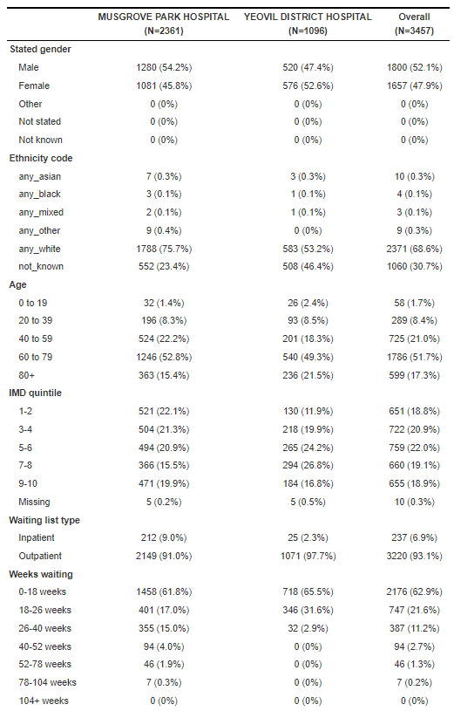
Hospital X
Hospital X
What is a health inequality
within a waiting list?
These approaches have flaws as they perhaps simply
describe the patients
Calculate local IMD for comparison
IMD contains an element of health outcome
– risk of self correlation
Quantitative or descriptive techniques
Comparison to rates by expected prevalence
Notes:
Descriptive data on waiting list
Very hard to take inference from this
Local IMDs give even comparisons across quintiles
Warning around IMD – self correlation

Slide 5
What is a health inequality within a waiting list?
What if there was a 95% to 5% percent split by gender on a waiting list?
Would we consider that to be a health inequality?
Conditions and disease do have a demographic prevalence
Literature review identified some previous work to look at distribution of waits, this mainly looked at the difference in mean and median, or via a survival analysis, many others tried to link to prevalence rates ⁽⁵⁾ ⁽⁶⁾
My hypothesis
If a waiting list is equitable, then the distribution of patient cohorts within the overall distribution would be the same
Notes:
Show how do you identify a health inequality
Gender split
Breast cancer waiting list
Either by gender, ethnicity and so some extent by IMD
Hypothesis – irrespective of the number split

Slide 6
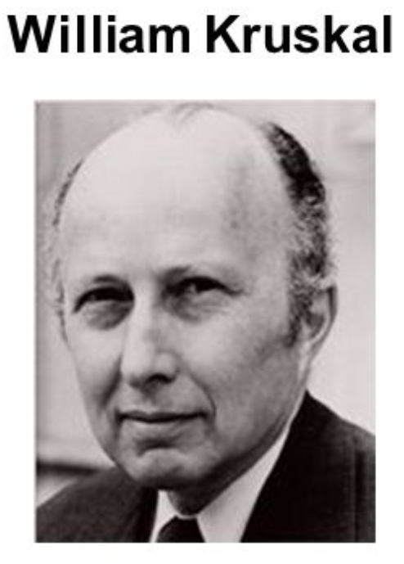
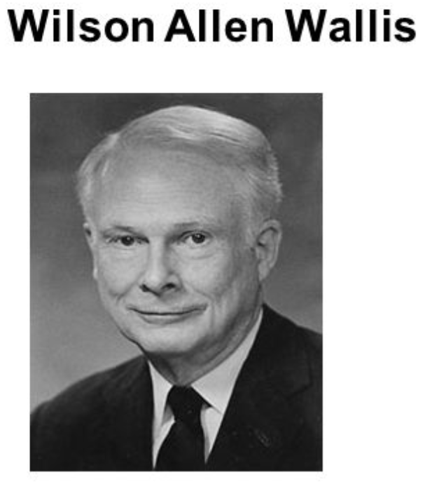
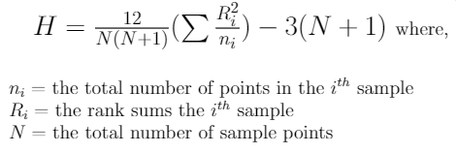
What is a health inequality within a waiting list?
Identified a statistical test to compare distributions of cohorts within a waiting list
Utilises a rank sum approach to compare sample significance across non parametric distributions ⁽⁷⁾
Created analytical pipeline to examine waiting lists
by treatment code, by organisation and by health
inequality demographic
Runs at scale and only return those that reach
statistical significance with a p value < 0.05
Where statistical significance identified run further pairwise
comparisons to identify significance between pairs within cohorts
Dynamically create exception report for analysis and discussion
Can be run for any treatment function
(with slight tweaks could be run for other regions)
Notes:
Kruskal Wallis test – owe them a pint
Runs at scale across all sites on a waiting list and returns exception report
- validated in background by generalised linear model based on gamma distribution
Runs further tests on statistical significant outliers
Can be run by treatment function

Slide 7
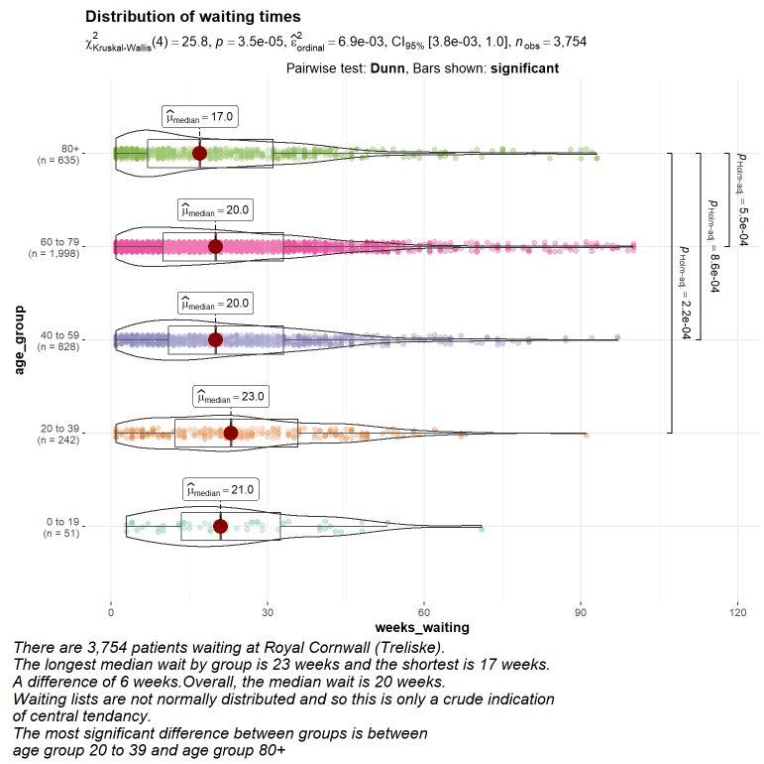
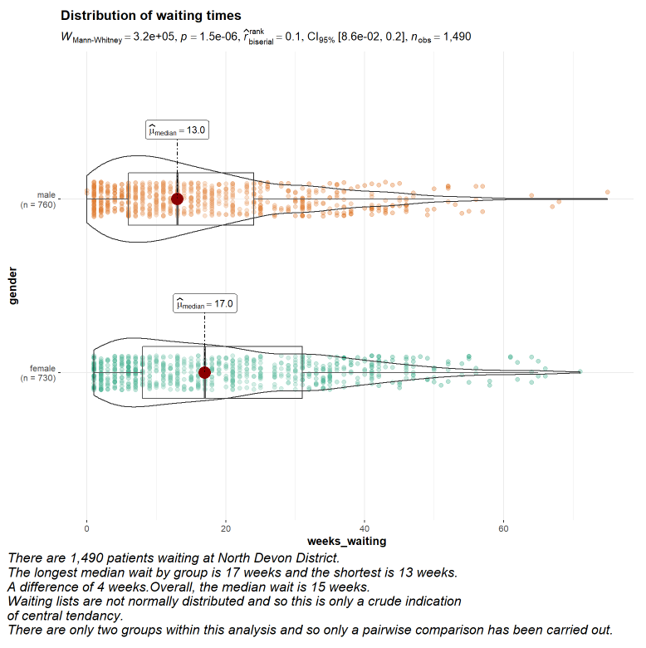
What is a health inequality within a waiting list?
Notes:
Examples of inequalities identified
Not going to name which waiting list this is-
Automated pairwise comparison
Automated descriptive text that adjusts to the data

Slide 8

What are the risks leading to emergency admission?
Chose to train a machine learning XGBoost ⁽⁸⁾ model
Flexible
In built capacity for missing values
Good performance
Interpretability of results, can give explainable feature importance
Rather than specific prediction, determining feature importance is the goal
Useful for risk stratification of patients and potential support of clinical triage
Notes:
Identifying risks that lead to emergency admission
Missing data – I know right?
Feature importance rather than full patient level predictive accuracy

Slide 9
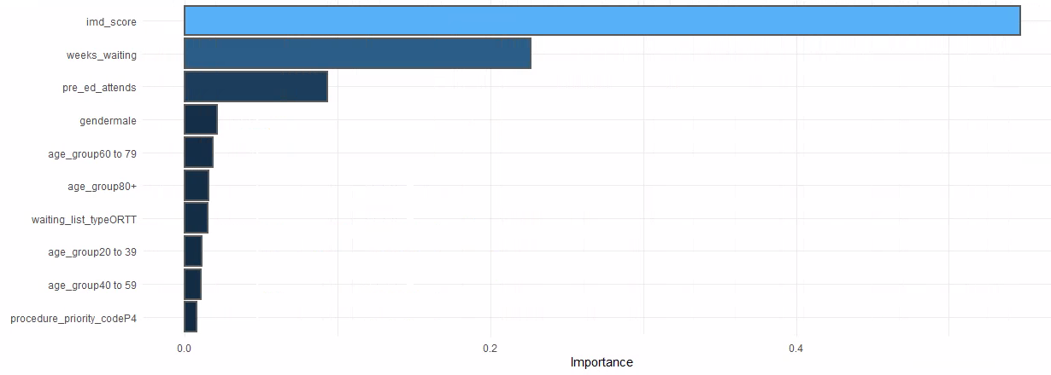
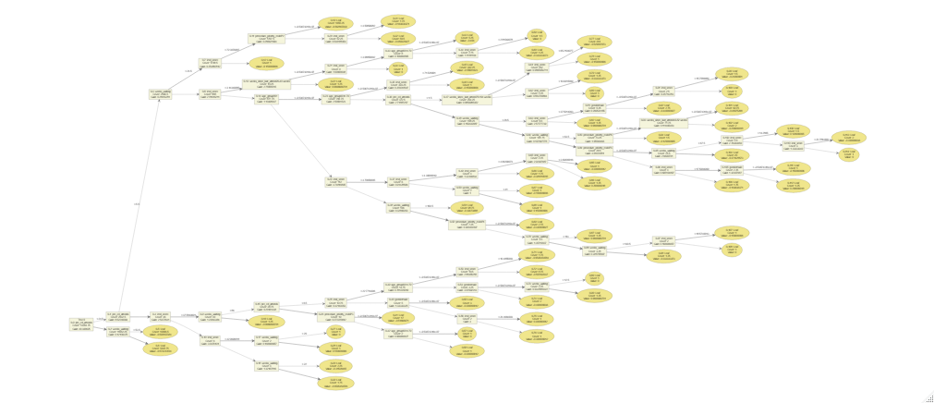
XG Boost Model
No need to scale or centre data
Creates a decision tree
Utilises a space filling parameter grid to try
various hyper parameters in the model
itself and selects best AOC
Uses 10 fold cross-validation using stratification
for tuning the model
Returns interpretable feature importance
Notes:
-XG Boost limited amounts of pre processing
-Still utilised some hyper parameter tuning into workflow
-Produce simple feature importance graph – the idea to make as simple as possible
-Creates an overall tree but that is not useful
-A really simple plot that is understandable to pull out feature importance
-A deprived older male patient who has been waiting a longer time and has attended ED several times whilst waiting, is at increased risk of becoming an emergency admission

Slide 10
Results
Reproducible analytical pipeline – code to be published
Feedback from operational leads, clinicians and analysts
Does identify elements of inequality
Risk factors – hardly breaking new ground but good to support intuition with data
Discussion
Not all inequalities picked up are necessarily an issue
Element of clinical decision making and ongoing risk stratification
Not all disparities are clinically meaningful – there may clinical need to prioritise treatment
Data quality is poor – especially around ethnicity
The pipeline is built so that additional features can easily be added to the analysis, things such as serious mental illness (SMI), learning disability (LD), long term conditions (LTC) etc
IMD is very crude and covers an area of up to 3,000 people
Notes:
-All about automation and reproducibility
-Feedback – has been excitement
-It does identify some inequalities
-Risk factors – stating the obvious
-Some inequalities my be clinically appropriate
-DQ around ethnicity not fit for purpose
-My code is open and accessible and easily adaptable
-IMD is crude – you and your neighbour are not the same

Slide 11
Conclusion
So much time wrangling the data
Report is just a snapshot
Additional features to be added, serious mental illness, learning disability, long term conditions, coastal status etc
More features, better analysis, better model!
Code written to be a simple adaption to add new features – can transfer to UDAL to be one workflow
- Choose a treatment function and one click to produce report
Utilised at local level to stratify risk and support clinical decision making
Used at a regional level to support strategic decision making and inequalities oversight
Invited onto national working group to discuss work and how it can be further developed
Notes:
-Pulling dataset together and understanding it has been a challenge
-Just a snapshot show does not identify change over time or trends
-More features can be added
-Improve the model
-UDAL – one click reporting
-Who is this report for – regional leads as well as local level providers
-Really proud to say work is being picked up and developed

Slide 12
Any questions?
Thank you!
References
⁽¹⁾ https://www.who.int/news-room/facts-in-pictures/detail/health-inequities-and-their-causes
⁽²⁾ NHS Data Model and dictionary - https://www.datadictionary.nhs.uk/classes/waiting_list.html
⁽³⁾ https://www.england.nhs.uk/about/equality/equality-hub/national-healthcare-inequalities-improvement-programme/core20plus5/
⁽⁴⁾ https://www.gov.uk/government/statistics/english-indices-of-deprivation-2019
⁽⁵⁾ Dimakou, S., Dimakou, O. & Basso, H.S. Waiting time distribution in public health care: empirics and theory. Health Econ Rev 5, 25 (2015).
⁽⁶⁾ Dimakou, S., Parkin, D., Devlin, N. et al. Identifying the impact of government targets on waiting times in the NHS. Health Care Manag Sci 12, 1 (2009)
⁽⁷⁾ Kruskal, W. H., & Wallis, W. A. (1952). Use of Ranks in One-Criterion Variance Analysis. Journal of the American Statistical Association, 47, 583-621.
⁽⁸⁾ Chen, T., & Guestrin, C. (2016). XGBoost: A Scalable Tree Boosting System. In Proceedings of the 22nd ACM SIGKDD International Conference on Knowledge Discovery and Data Mining (pp. 785–794). New York, NY, USA: ACM.
Thanks to
Lucy Wellesley-Miller, Vicki Cruize, Tobin Savage, Jo Mcsweeny, Martin Huscroft, Julia Gonzalez-Esquerre, Martin Pitt, William Henley
and many others for support with the project

